Slide 1
Modern Computing Systems Design (CSE 2221)
3rd SEMESTER – CSE (AIML, DS, IOT, CYSC)

Slide 2
Chapter-3 : Processor Element
This chapter introduces the conceptual design and core functionality of a modern processor, focusing on the internal mechanisms that allow it to execute instructions, manage data, and communicate with the outside world.

Slide 3
Chapter-3 : Processor Element
The following topics will be covered in this chapter:
A simple processor
The instruction set
Addressing modes
Instruction categories
Interrupt processing
Input/output operations

Slide 4
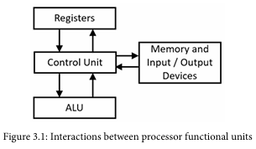
Chapter-3 : Processor Element
A Simple Processor
Central Processing Unit (CPU)

Slide 5
Chapter-3 : Processor Element
A Simple Processor
The fundamental architectural units common to almost all CPUs:
Control Unit :
Acts as the brain of the processor.
Fetches instructions from memory.
Decodes the instructions to determine the required operation.
Generates control signals to coordinate the ALU, registers, and other components to execute the instruction.
Manages the sequence of execution.

Slide 6
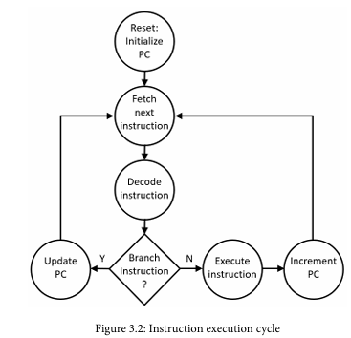
Chapter-3 : Processor Element
Control Unit :

Slide 7
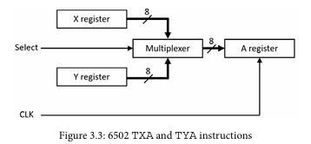
Chapter-3 : Processor Element
Control Unit :
Executing an Instruction:

Slide 8
Chapter-3 : Processor Element
Arithmetic Logic Unit (ALU) :
The execution unit for all computational tasks.
Performs Arithmetic Operations (addition, subtraction, multiplication, division).
Performs Logical Operations (AND, OR, NOT, XOR).

Slide 9
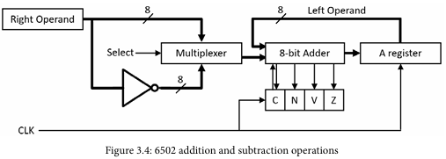
Chapter-3 : Processor Element
ALU Unit :
Example: ADC and SBC instructions

Slide 10
Chapter-3 : Processor Element
Registers:
Small, ultra-fast storage locations located inside the CPU.
They hold data, addresses, and status information actively being used by the current instruction.
Types include general-purpose registers (for data manipulation), program counter (holds the address of the next instruction), and status/flag registers (reflect results of operations).

Slide 11
Chapter-3 : Processor Element
Registers:
RISC Architecture vs CISC Architecture :
RISC | CISC
It stands for Reduced Instruction Set Computer. | It stands for Complex Instruction Set Computer.
It is a microprocessor architecture that uses small instruction set of uniform length. | This offers hundreds of instructions of different sizes to the users.
These simple instructions are executed in one clock cycle. | This architecture has a set of special purpose circuits which help execute the instructions at a high speed.
These chips are relatively simple to design. | These chips are complex to design.
They are inexpensive. | They are relatively expensive.
More numbers of registers | Less number of registers

Slide 12
Chapter-3 : Processor Element
Registers:
RISC Architecture vs CISC Architecture :
RISC | CISC
Most of the operations are based on registers which reduces the need to access memory | Most of the operations are memory based
It has less number of instructions. | It has more number of instructions.
It has fixed-length encodings for instructions. | It has variable-length encodings of instructions.
Simple addressing formats are supported. | The instructions interact with memory using complex addressing modes.
Separate LOAD/Store instructions are used to access memory operand. | No Separate LOAD/STORE instructions are available
Examples of RISC chips include ARM, RISC-V | Examples of CISC include x86 Architecture

Slide 13
Chapter-3 : Processor Element
Addressing Modes:
The way in which an operand is denoted in an instruction is known as addressing modes.
Addressing modes are techniques used by the CPU to identify the location of the operand(s) needed for executing an instruction. They provide rules for interpreting the address field in an instruction, helping the CPU fetch operands correctly.
Opcode – Tells the CPU what operation to perform (e.g., ADD, MOV).
Operands – The data or addresses on which the operation is performed.

Slide 14
Chapter-3 : Processor Element
Addressing Modes:
There are 9 different addressing modes used in 6502 processor.
Immediate Addressing mode
Absolute Addressing mode
Absolute indexed addressing mode
Indirect indexed addressing mode
Indexed indirect addressing mode
Absolute indirect addressing mode
Zero-page addressing mode
Implicit (Implied) addressing mode
Accumulator addressing mode

Slide 15
Addressing Modes:
Chapter-3 : Processor Element
1. Immediate addressing mode: In this addressing mode the value (data operand) is provided in the instruction itself.
Ex: LDA #$123 (the value after # indicates the data)
ADC #12
2. Absolute addressing mode: The addressing mode in which the 16-bit address of the memory is provided in the instruction.
Ex: CMP $FE02 ; compare A with byte at &FE02
3. Absolute indexed addressing mode: The addressing mode in which the memory address is computed by adding a base address provided in the instruction to a value contained in the X or Y register.
Ex: LDA $123, X ($123 specifies the address) -> Absolute X-Indexed addressing mode
ADC $432, Y ($123 specifies the address) -> Absolute Y-Indexed addressing mode
4. Indirect indexed addressing mode: In this addressing mode, the memory location/address of the operand is calculated by adding the content of Y register with the content of base address which is 8-bit address.
Ex: ADC ($10), Y ($10 specifies the address)

Slide 16
Addressing Modes:
Chapter-3 : Processor Element
5. Zero page addressing mode:
When a zero page address (0x00-0xFF, refers to the high byte of 16-bit address) is used, it is called as Zero page addressing mode.
Ex: LDA $C5
6. Indexed indirect addressing mode: In this addressing mode, the memory location/address of the operand is calculated by adding the content of X register with base address which is 8-bit address.
Ex: LDA ($10, X)
6. Absolute indirect addressing mode: The addressing mode that uses 16-bit pointer to final address.
Ex: JMP ($1234)
7. Implicit (Implied) addressing mode: In this addressing mode, no operand is specified in the instruction (instruction implies the data itself)
Ex: PHA
RST

Slide 17
Addressing Modes:
Chapter-3 : Processor Element
8. Relative addressing mode: In this addressing mode Branch target as signed offset from PC
Ex: BEQ $34
BNE $34
9. Accumulator addressing mode: The addressing mode in which the operation is performed with/to the accumulator.
Ex: ASL,
LSR,

Slide 18
Chapter-3 : Processor Element
Instruction Set of 6502 processor:
A functional breakdown of the 6502-instruction set is commonly categorized as follows:
Load/store instructions:
These instructions move data between the processor's registers and memory.
LDA (Load Accumulator)
LDX (Load X Register)
LDY (Load Y Register)
STA (Store Accumulator)
STX (Store X Register)
STY (Store Y Register)
Register transfer instructions:
These instructions move data between the processor's main registers.
TAX (Transfer Accumulator to X)
TAY (Transfer Accumulator to Y)
TXA (Transfer X to Accumulator)
TYA (Transfer Y to Accumulator)

Slide 19
Chapter-3 : Processor Element
Instruction Set of 6502 processor:
Stack instructions:
These instructions handle pushing and pulling data to and from the stack, which resides on memory page $01.
PHA (Push Accumulator)
PHP (Push Processor Status)
PLA (Pull Accumulator)
PLP (Pull Processor Status)
TSX (Transfer Stack Pointer to X)
TXS (Transfer X to Stack Pointer)
Arithmetic and logical instructions:
This category includes instructions for mathematical operations and logical bit manipulation.
ADC (Add with Carry) ROL (Rotate Left)
SBC (Subtract with Carry) ROR (Rotate Right)
AND (Logical AND) INC (Increment Memory)
EOR (Exclusive OR) INX (Increment X Register)
ORA (Logical OR) INY (Increment Y Register)
ASL (Arithmetic Shift Left) DEC (Decrement Memory)
LSR (Logical Shift Right) DEX (Decrement X Register)
DEY (Decrement Y Register)

Slide 20
Chapter-3 : Processor Element
Instruction Set of 6502 processor:
Comparison and bit test instructions:
These instructions compare values and set the status register flags accordingly.CMP (Compare Accumulator).
CPX (Compare X Register)
CPY (Compare Y Register)
BIT (Bit Test)
Conditional branch instructions:
These instructions alter the program flow based on the state of the status flags.
BCC (Branch if Carry Clear)
BCS (Branch if Carry Set)
BEQ (Branch if Equal)
BMI (Branch if Minus)
BNE (Branch if Not Equal)
BPL (Branch if Plus)
BVC (Branch if Overflow Clear)
BVS (Branch if Overflow Set)

Slide 21
Chapter-3 : Processor Element
Instruction Set of 6502 processor:
Unconditional jump instructions:
These instructions change the program counter to a new address.
JMP (Jump)
JSR (Jump to Subroutine)
RTS (Return from Subroutine)
RTI (Return from Interrupt)
Flag control instructions:
These instructions are used to manually set or clear specific flags in the status register.
CLC (Clear Carry Flag)
CLD (Clear Decimal Flag)
CLI (Clear Interrupt Disable)
CLV (Clear Overflow Flag)
SEC (Set Carry Flag)
SED (Set Decimal Flag)
SEI (Set Interrupt Disable)
System instructions:
This category covers miscellaneous system-level functions.
BRK (Force Interrupt)
NOP (No Operation)
SEI
CLI

Slide 22
Chapter-3 : Processor Element
Input/Output (I/O) Operations:
The goal of the I/O portion of a processor architecture is to efficiently transfer data between external peripheral devices and system memory.
The processor uses the instruction categories, addressing modes, and interrupt processing methods for interactions with I/O devices.
Two main approaches employed in modern processors to access I/O devices.
Memory-Mapped I/O:
where I/O registers are accessed like memory locations, used by 6502, ARM
It dedicates portions of the system address space to I/O devices. The processor accesses peripheral devices at predefined addresses using the same instructions and addressing modes it uses to read and write system memory.
Port-Mapped I/O :
where a separate address space and special I/O instructions are used, like in x86 architecture).
I/O devices are assigned port numbers as addresses.

Slide 23
Chapter-3 : Processor Element
Input/Output (I/O) Operations:
Programmed I/O (Polling):The CPU constantly checks the status register of the I/O device in a loop, waiting for it to be ready. Simple, but highly inefficient due to wasted CPU cycles.
Interrupt-Driven I/O: The CPU initiates a command, then moves on to other tasks. The I/O device generates an interrupt signal when the operation is complete or when it needs service, making the process much more efficient.
Direct Memory Access (DMA):A separate DMA controller handles the direct transfer of large blocks of data between memory and an I/O device (e.g., a disk drive).The CPU only initiates the transfer and is only interrupted when the entire block transfer is complete, maximizing CPU availability.

Slide 24
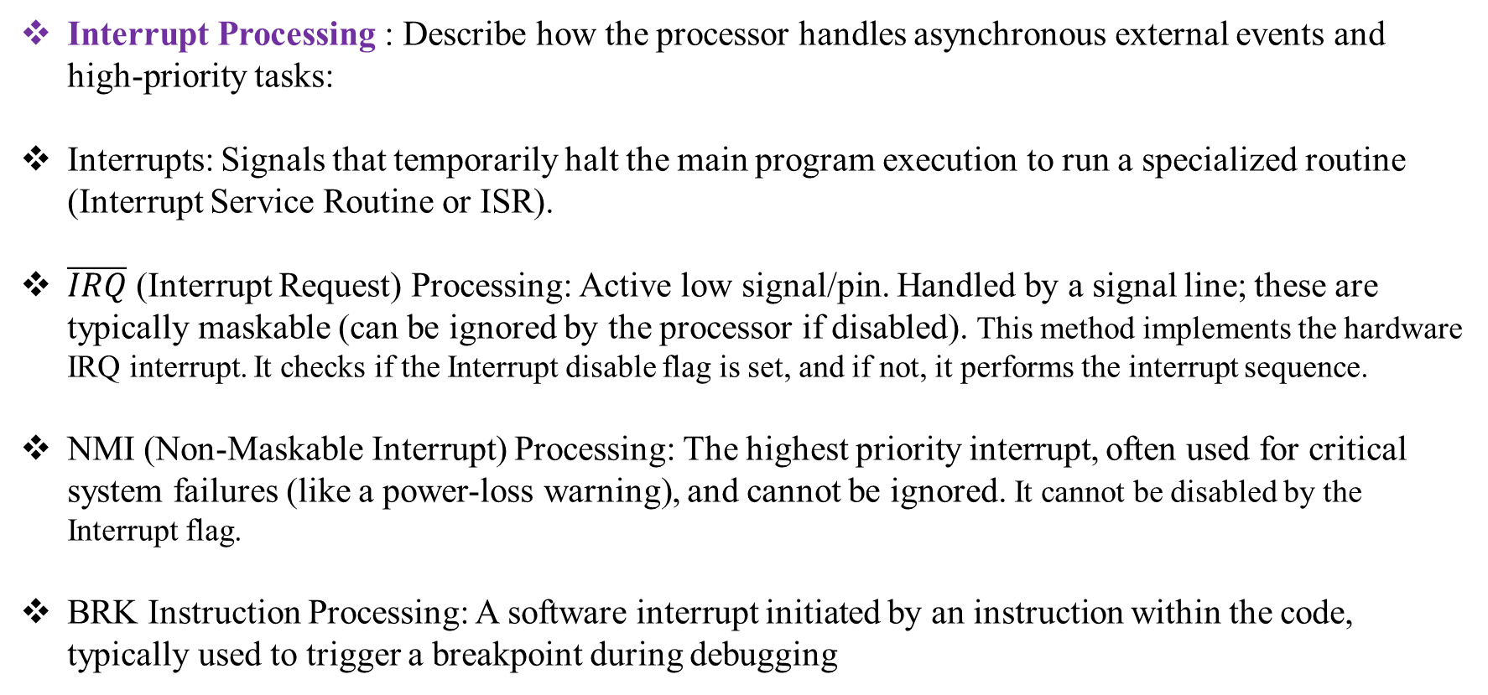
Chapter-3 : Processor Element
Interrupt Processing : Describe how the processor handles asynchronous external events and high-priority tasks:
Interrupts: Signals that temporarily halt the main program execution to run a specialized routine (Interrupt Service Routine or ISR).
$\overline{IRQ}$ (Interrupt Request) Processing: Active low signal/pin. Handled by a signal line; these are typically maskable (can be ignored by the processor if disabled). This method implements the hardware IRQ interrupt. It checks if the Interrupt disable flag is set, and if not, it performs the interrupt sequence.
NMI (Non-Maskable Interrupt) Processing: The highest priority interrupt, often used for critical system failures (like a power-loss warning), and cannot be ignored. It cannot be disabled by the Interrupt flag.
BRK Instruction Processing: A software interrupt initiated by an instruction within the code, typically used to trigger a breakpoint during debugging

Slide 25
Chapter-3 : Processor Element
Interrupt Processing : MOS6502 processor supports three types of interrupts, each with its own vector location and handling behavior:
nterrupt Type | Vector Location | Maskable | Description
IRQ | 0xFFFE-0xFFFF | Yes | Hardware interrupt that can be disabled by setting the I flag
NMI | 0xFFFA-0xFFFB | No | Non-maskable interrupt that always triggers regardless of I flag
BRK | 0xFFFE-0xFFFF | Yes | Software interrupt triggered by the BRK instruction
Reset | 0xFFFC-0xFFFD | No | System reset (not technically an interrupt)

Slide 26
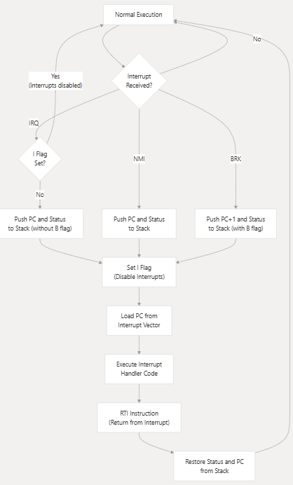
Chapter-3 : Processor Element
Interrupt Handling Process:
:

Slide 27
Chapter-3 : Processor Element
Interrupt Processing :
Detailed Interrupt Sequence
The following steps show the exact sequence of operations performed during interrupt handling:
IRQ (Interrupt Request)
Check if the Interrupt disable (I) flag is clear
If I is set, the interrupt is ignored
Push the high byte of PC to the stack (decrements SP)
Push the low byte of PC to the stack (decrements SP)
Push the status register to the stack with B flag clear (decrements SP)
Set the I flag to disable further interrupts
Load the new PC from the IRQ vector (0xFFFE-0xFFFF)
Continue execution at the new PC

Slide 28
Chapter-3 : Processor Element
Interrupt Processing :
Detailed Interrupt Sequence
The following steps show the exact sequence of operations performed during interrupt handling:
NMI (Non-Maskable Interrupt)
Push the high byte of PC to the stack (decrements SP)
Push the low byte of PC to the stack (decrements SP)
Push the status register to the stack with B flag clear (decrements SP)
Set the I flag to disable further interrupts
Load the new PC from the NMI vector (0xFFFA-0xFFFB)
Continue execution at the new PC

Slide 29
Chapter-3 : Processor Element
Interrupt Processing :
Detailed Interrupt Sequence
The following steps show the exact sequence of operations performed during interrupt handling:
BRK (Software Interrupt)
BRK is an instruction (opcode 0x00) rather than a hardware signal. When executed:
Increment PC (to skip the byte following the BRK opcode)
Push the high byte of PC to the stack (decrements SP)
Push the low byte of PC to the stack (decrements SP)
Push the status register to the stack with B flag set (decrements SP)
Set the I flag to disable further interrupts
Load the new PC from the IRQ/BRK vector (0xFFFE-0xFFFF)
Continue execution at the new PC
RTI (Return from Interrupt)
The RTI instruction (opcode 0x40) restores the processor state after an interrupt:
Pull the status register from the stack (increments SP)
Pull the low byte of PC from the stack (increments SP)
Pull the high byte of PC from the stack (increments SP)
Continue execution at the restored PC

